Slide 1
Unit 2
Models of Network Administration

Slide 2
Administration Models
• Reboot: The reboot habit should, of course, be stifled. More mature
preemptive systems like Unix and perhaps NT should almost never need to be rebooted, indeed it can be damaging to do so. Rebooting a multi-user system is
dangerous since users might be logged in from remote locations and could lose data.
Manual: the default approach to system management is to allow qualified humans do everything by hand. This approach suffers from a lack of scalability. It suffers from human flaws and a lack of intrinsic documentation. Humans are not well-disciplined at documenting their work, or their intended configurations. There are also issues concerned with communication and work in a team which can interfere with the smooth running of systems.

Slide 3
Control: another approach to system administration is the use of control systems. Tivoli, HP OpenView and Sun Solstice are examples of these. In the control approach, the system administrator follows the state of the network by defining error conditions to look for. A process on each host reports errors as they occur to the administrator. In this way the administrator has an overview of every problem on the network from his/her single location, and can either fix the problems by hand as they occur
Immunology (self-maintenance): a relatively new approach to system management which is growing in popularity is the idea of equipping networked operating systems with a simple immune system.
In an immunological model, the aim is to minimize the involvement of a human being as far as possible. The tool cfengine introduced a technology which promotes this approach.

Slide 4
Immunity and Convergence
The immunity model is about self-sufficient maintenance and is of central importance to all scalable approaches to network management, since it is the only model which scales trivially with the number of networked hosts. The idea behind immunity is to automate host maintenance in such a way as to give each host responsibility for its own configuration.
All collective systems (including all biological phenomena) are moderated and stabilized by a cooperative principle of feedback regulation. This regulating principle is sometimes called the Prey-Predator scenario, because it is about competition between different parts of a system. When one part of the system starts to grow out of control, it tends to favor the production of an antidote which keeps that part in check
Similarly, the antidote cannot exist without the original system, so it cannot go so far as to destroy the original system, since it destroys itself in the process

Slide 5
The idea of immunity requires a notion of convergence. Convergence means that maintenance work (the counter force or antidote) tends to bring a host to a state of equilibrium, i.e. a stable state, which is the state we would actually like the system to be in. The more maintenance which is performed, the closer we approach the ideal state of the system

Slide 6
Network Immunity Manager provides an affordable, scalable, and easily managed method for providing per port intrusion detection and response to stop malicious network traffic at the edge of the network supports security policy setting and monitors network activity for anomalous behaviors that may indicate the presence of security threat s such as worms, or viruses.
NIM detects viruses by behavior anomaly detection on sampled traffic, and it accepts virus throttling alerts from switches.
Network Immunity Manager can be used to automatically detect and respond to virus attacks on per port basis. It lets you create automated threat response policies, and you can create on-demand reports for Security activity such as alerts generated and actions taken by policies

Slide 7
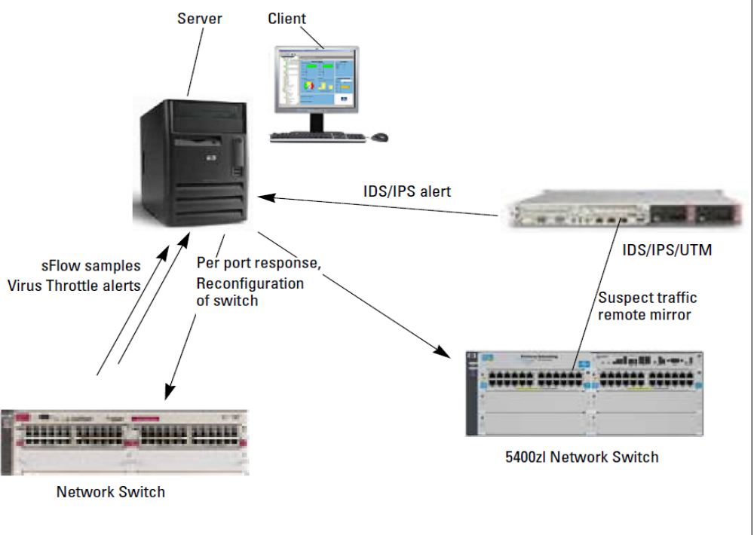
NIM Architecture

Slide 8
The sFlow standard (RFC 3176) describes a mechanism to capture traffic data in switched or routed networks. It uses a sampling technology to collect statistics from the device and is for this reason applicable to high speed networks (at gigabit speeds or higher).
Virus Throttling Also referred to as connection rate filtering, Virus Throttling (VT) can be used to block traffic from a host exhibiting a relatively high incidence of attempts to connect with other devices. You can set VT to block traffic permanently (until administrator re-configures to allow traffic), or to throttle (block) traffic temporarily from the host for a calculated period of time, and then allow traffic to resume. If the undesired behavior persists, the cycle is repeated. You can also use VT in Notify Only mode so that the administrator is advised when VT events occur, without blocking traffic.

Slide 9
Network Organization
A system administrator has to choose the players and assign them their
roles on the basis of the job which is intended for the computer system. There are two aspects of this to consider: the machine aspect and the human aspect.
The machine aspect relates to the use of computing machinery to achieve a functional infrastructure;
the human aspect is about the way people are deployed to build and maintain that infrastructure.
Principle (Homogeneity/Uniformity I) System homogeneity or uniformity means that all hosts appear to be essentially the same. This makes hosts predictable for users and manageable for administrators. It allows for reuse of hardware in an emergency.

Slide 10
Having chosen the necessary hardware and software, we have to address the function of each host within the community, i.e. the delegation of specialized tasks called services to particular hosts, and also the competition between users and hosts for resources, both local and distributed. For all of this to work with some measure of equilibrium, it has to be carefully planned and orchestrated
LOAD BALANCING
For large numbers of hosts, distributed over several locations, consider a policy of delegating responsibility to a local administrator with closer knowledge of
the hosts' patterns of usage. Zones of responsibility allow local experts to do their jobs.

Slide 11
Bootstrapping Infrastructure
In a network, instead of view system individually we view all systems as a virtual machine and this machine is assigned to execute a common task.
Principle (Scalability) Any model of system infrastructure must be able to scale efficiently to large numbers of hosts (and perhaps subnets, depending on the local netmask).
Principle (Reliability) Any model of system infrastructure must have reliability as one of its chief goals. Down-time can often be measured in real money. MAINTENANCE
Corollary (Redundancy) Reliability is safeguarded by redundancy, or backup services running in parallel, ready to take over at a moment's notice. RAID

Slide 12
Virtual Machine Model

Slide 13
Creating Uniformity Through Automation
Principle (Abstraction generalizes) Expressing tasks in an operating-system independent language reduces time spent debugging, promotes homogeneity and avoids unnecessary repetition.
Suggestion (Platform independent languages) Use languages and tools which are independent of operating system peculiarities, e.g. cf engine perl, python. More importantly, use the right tool for the right job.

Slide 14
Push Models and Pull Models
Push: the model is epitomized by the rdist program. Pushing files from a central
location to a number of hosts is a way of forcing a file to be written to a group of hosts.
Pull the pull model is represented by cfengine and rsync. With a pull model, each host decides to collect files from a central repository, of its own volition. The advantage of this approach is that there is no need to open a host to control from outside, other than the trust implied by accepting configuration files from the distributing host.

Slide 15
Reliability
One of the aims of building a sturdy infrastructure is to cope with the results of failure. Failure can encompass hardware and software. It includes downtime due to physical error (power, net cables and CPUs) and also downtime due to software crashes. The net result of any failure is loss of service. Our only defense against actual failure is parallelism, or redundancy. RAID
Cfengine: Policy Automation
Cfengine is a system administration tool consisting of two elements: a language and a configuration engine.
Together these are used to instruct and enable all hosts on a network about how to configure and maintain themselves
Its primary function is to provide automated configuration and maintenance of computers, from a policy specification.

Slide 16
What makes cfengine different from scripting languages is the high level at which is operates. Rather than allowing complete programming generality, cfengine provides a set of intelligent primitives for configuring and maintaining systems.
As a system inevitably drifts from its ideal state, a cfengine policy brings it back to that ideal state.
Cfengine works from a central configuration, maintained from one location. That central configuration describes the entire network by referring to classes and types of host.

Slide 17
Here is a summary of cfengine's capabilities:
• Check and configure the network interface on network hosts.
• Edit text files for the system or for all users.
• Make and maintain symbolic links, including multiple links from a single command.
• Check and set the permissions and ownership of files.
• Tidy (delete) junk files which clutter the system.
• Systematic, automated (static) mounting of NFS file systems.
• Checking for the presence or absence of important files and file systems.

Slide 18
How Does Cfengine Work?
Mostly Declarative Language
Cfengine has its own mostly declarative language. This describes how things should be; with a little bit of imperative (which describes how to do it, or what to do).
Cfengine’s declarative language is used to write configuration “policy rules” or “promises” of how the system should be configured.
Cfengine Design: Resilience
Cfengine pulls down its config from a policy server, or if the policy server is unavailable or has not been configured, from local cache at /var/cfengine/inputs.
In other words, it can run standalone, as as part of a distributed system.
Therefore Cfengine will keep running even if there is a network outage or a policy server outage. It will use its cached copy of the last known policy.
Cfengine Design: Scalability
Each host is responsible for carrying out checks and maintenance on itself, based on its local copy of policy. Cfengine could scale to an infinite number of hosts.

Slide 19
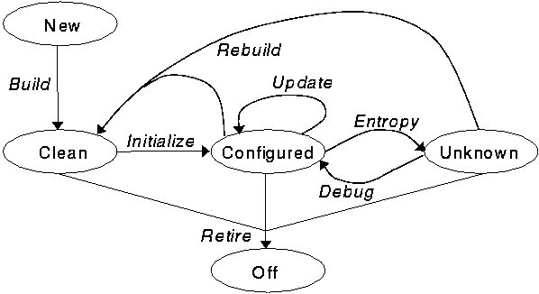
The primary principle of Cfengine is automatic convergence from Clean or Unknown states back to Configured

Slide 20
Promises and Patterns
Cfengine 3 is about Promises and Patterns of Promises.
Promises
A promise is a Cfengine policy statement - for example, that /etc/shadow is only readable by root - and it implies Cfengine will endeavor to keep that promise.
Patterns
A “configuration” is a design arrangement or a pattern you make with system resources. The cfengine language makes it easy to describe and implement patterns using tools like lists, bundles and regular expressions. While promises are things that are kept, the efficiencies of configuration come from how the promises form simple re-usable patterns.

Slide 21
The basic grammar of Cfengine 3 looks like this:
type: classes:: "promiser" -> { "promisee1", "promisee2", ... }
attribute_1 => value_1, attribute_2 => value_2, ... attribute_n => value_n;
List of promise types
commands - Run external commands
files - Handle files (permissions, copying, etc.)
edit_line - Handle files (content)
interfaces - Network configuration
methods - Methods are compound promises that refer to whole bundles of promises.
packages - Package management
processes - Process management
storage - Disk and filesystem management
http://www.verticalsysadmin.com/cfengine3/
http://cfengine.com/

Slide 22
SNMP
Simple Network Management Protocol

Slide 23
What is Network Management?
Basic tasks that fall under this category are:
Configuration Management
Keeping track of device settings and how they function
Fault Management
Dealing with problems and emergencies in the network (router stops routing, server loses power, etc.)
Performance Management
How smoothly is the network running?
Can it handle the workload it currently has?

Slide 24
Network Management must be...
The management interface must be...
Standardized
Extendible
Portable
The management mechanism must be...
Inexpensive
Implemented as software only

Slide 25
Functional Areas of Network Management
Configuration Management - inventory, configuration, provisioning
Fault Management - reactive and proactive network fault management
Performance Management - # of packets dropped, timeouts, collisions, CRC errors
Security Management - SNMP doesn’t provide much here
Accounting Management - cost management and chargeback assessment
Asset Management - statistics of equipment, facility, and administration personnel
Planning Management - analysis of trends to help justify a network upgrade or bandwidth increase

Slide 26
Versions
Two major versions SNMPv1, SNMPv2
SNMPv1 is the recommended standard
SNMPv2 has become split into:
SNMPv2u - SNMPv2 with user-based security
SNMPv2* - SNMPv2 with user-based security and additional features
SNMPv2c - SNMPv2 without security

Slide 27
What is SNMP?
SNMP is a protocol that allows for remote and local management of items on the network including servers, workstations, routers, switches and other managed devices.
Comprised of agents and managers
Agent - process running on each managed node collecting information about the device it is running on.
Manager - process running on a management workstation that requests information about devices on the network.

Slide 28
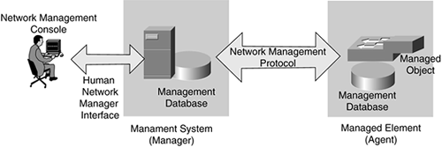

Slide 29
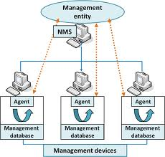

Slide 30
Advantages of using SNMP
Standardized
universally supported
extendible
portable
allows distributed management access
lightweight protocol

Slide 31
Client Pull & Server Push
SNMP is a “client pull” model
The management system (client) “pulls” data from the agent (server).
SNMP is a “server push” model
The agent (server) “pushes” out a trap message to a (client) management system

Slide 32
Ports & UDP
SNMP uses User Datagram Protocol (UDP) as the transport mechanism for SNMP messages
Ethernet Frame
IP Packet
SNMP Message
CRC
UDP Datagram
Like FTP, SNMP uses two well-known ports to operate:
UDP Port 161 - SNMP Messages
UDP Port 162 - SNMP Trap Messages

Slide 33
The Three Parts of SNMP
SNMP network management is based on three parts:
SNMP Protocol
Defines format of messages exchanged by management systems and agents.
Specifies the Get, GetNext, Set, and Trap operations
Structure of Management Information (SMI)
Rules specifying the format used to define objects managed on the network that the SNMP protocol accesses
Management Information Base (MIB)
A map of the hierarchical order of all managed objects and how they are accessed

Slide 34
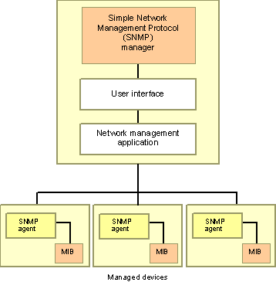

Slide 35
Nodes
Items in an SNMP Network are called nodes. There are different types of nodes.
Managed nodes
Typically runs an agent process that services requests from a management node
Management nodes
Typically a workstation running some network management & monitoring software
Nodes that are not manageable by SNMP
A node may not support SNMP, but may be manageable by SNMP through a proxy agent running on another machine
Nodes can be both managed nodes and a management node at the same time (typically this is the case, since you want to be able to manage the workstation that your management application is running on.)

Slide 36
Community Names
Community names are used to define where an SNMP message is destined for.
They mirror the same concept as a Windows NT or Unix domain.
Set up your agents to belong to certain communities.
Set up your management applications to monitor and receive traps from certain community names.

Slide 37
SNMP Agents
Two basic designs of agents
Extendible Agents
Open, modular design allows for adaptations to new management data and operational requirements
Monolithic Agents
not extendible
optimized for specific hardware platform and OS
this optimization results in less overhead (memory and system resources) and quicker execution

Slide 38
Proxy & Gateway Agents
Proxy & Gateway Agents extend the capabilities of SNMP by allowing it to:
Manage a device that cannot support an SNMP agent
Manage a device that supports a non-SNMP management agent
Allow a non-SNMP management system to access an SNMP agent
Provide firewall-type security to other SNMP agents (UDP packet filtering)
Translate between different formats of SNMP messages (v1 and v2)
Consolidate multiple managed nodes into a single network address (also to provide a single trap destination)

Slide 39
Four Basic Operations
Get
Retrieves the value of a MIB variable stored on the agent machine
(integer, string, or address of another MIB variable)
GetNext
Retrieves the next value of the next lexical MIB variable
Set
Changes the value of a MIB variable
Trap
An unsolicited notification sent by an agent to a management application (typically a notification of something unexpected, like an error)

Slide 40
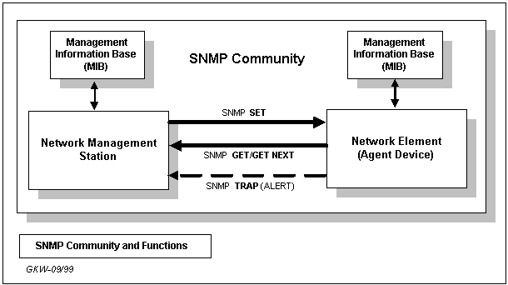
SNMP

Slide 41
Traps
Traps are unrequested event reports that are sent to a management system by an SNMP agent process
When a trappable event occurs, a trap message is generated by the agent and is sent to a trap destination (a specific, configured network address)
Many events can be configured to signal a trap, like a network cable fault, failing NIC or Hard Drive, a “General Protection Fault”, or a power supply failure
Traps can also be throttled -- You can limit the number of traps sent per second from the agent
Traps have a priority associated with them -- Critical, Major, Minor, Warning, Marginal, Informational, Normal, Unknown

Slide 42
Trap Receivers
Traps are received by a management application.
Management applications can handle the trap in a few ways:
Poll the agent that sent the trap for more information about the event, and the status of the rest of the machine.
Log the reception of the trap.
Completely ignore the trap.
Management applications can be set up to send off an e-mail, call a voice mail and leave a message, or send an alpha-numeric page to the network administrator’s pager that says:
Your PDC just Blue-Screened at 03:46AM. Have a nice day. :)

Slide 43
Languages of SNMP
Structure of Management Information (SMI)
specifies the format used for defining managed objects that are accessed via the SNMP protocol
Abstract Syntax Notation One (ASN.1)
used to define the format of SNMP messages and managed objects (MIB modules) using an unambiguous data description format
Basic Encoding Rules (BER)
used to encode the SNMP messages into a format suitable for transmission across a network

Slide 44
SMIv1
Structure of Management Information
SMIv1 is described in RFCs 1155, 1212, 1215
These RFCs describe:
How MIB modules are defined with CCITT X.208 ASN.1 data description language
The subset of the ASN.1 language that is used in MIBs
The addition of the APPLICATION data type to ASN.1, specifically for use with SNMP MIBs
All ASN.1 constructs are serialized using the CCITT X.209 BER for transmission across the wire
definition of the high-level structure of the Internet branch (iso(1).org(3).dod(6).internet(1)) of the MIB naming tree
the definition and description of an SNMP managed object

Slide 45
SMIv2
Structure of Management Information
SMIv2 is described in RFCs 1442, 1443, 1444
These RFCs describe:
SMIv2 is a backward compatible update to SMIv1
The only exception is the Counter64 type defined by SMIv2
Counter64 cannot be created in SMIv2
RFC 2089 defines how bilingual (SMIv1 & SMIv2) agents handle the Counter64 data type
IETF requires that new and revised RFCs specify MIB modules using SMIv2

Slide 46
ASN.1
Abstract Syntax Notation One
ASN.1 is nothing more than a language definition. It is similar to C/C++ and other programming languages.
Syntax examples:
-- two dashes is a comment -- The C equivalent is written in the comment
MostSevereAlarm ::= INTEGER -- typedef MostSevereAlarm int;
circuitAlarms MostSevereAlarm ::= 3 -- MostSevereAlarm circuitAlarms = 3;
MostSevereAlarm ::= INTEGER (1..5) -- specify a valid range
ErrorCounts ::= SEQUENCE {
circuitID OCTET STRING,
erroredSeconds INTEGER,
unavailableSeconds INTEGER
} -- data structures are defined using the SEQUENCE keyword

Slide 47
BER
Basic Encoding Rules
The relationship between ASN.1 and BER parallels that of source code and machine code.
CCITT X.209 specifies the Basic Encoding Rules
All SNMP messages are converted / serialized from ASN.1 notation into smaller, binary data (BER)

Slide 48
SNMP Data Types
Yellow items defined by ASN.1
Orange items defined by RFC 1155
INTEGER -- signed 32-bit integer
OCTET STRING
OBJECT IDENTIFIER (OID)
NULL -- not actually data type, but data value
IpAddress -- OCTET STRING of size 4, in network byte order (B.E.)
Counter -- unsigned 32-bit integer (rolls over)
Gauge -- unsigned 32-bit integer (will top out and stay there)
TimeTicks -- unsigned 32-bit integer (rolls over after 497 days)
Opaque -- used to create new data types not in SNMPv1
DateAndTime, DisplayString, MacAddress, PhysAddress, TimeInterval, TimeStamp, TruthValue, VariablePointer -- textual conventions used as types

Slide 49
Managed “Objects” & MIBs
Always defined and referenced within the context of a MIB
A typical MIB variable definition:
sysContact OBJECT-TYPE -- OBJECT-TYPE is a macro
SYNTAX DisplayString (SIZE (0..255))
ACCESS read-write -- or read-write, write-only, not-accessible
STATUS mandatory -- or optional, deprecated, obsolete
DESCRIPTION
“Chris Francois
cfrancois@acm.org
(360)650-0000”
::= { system 4 }

Slide 50
Basic Message Format
Message Length
Message Version
Message Preamble
Community String
PDU Header
SNMP Protocol Data Unit
PDU Body

Slide 51
SNMP Message Formats
Message Length
SNMP Message Preamble
Message Version
Message Length
Community String
Message Version
PDU Type
Community String
PDU Length
PDU Type
PDU Length
Enterprises MIB OID
PDU Header
Agent IP Address
Request ID
Standard Trap Type
Error Status
Specific Trap Type
Error Index
Time Stamp
Length of Variable Bindings
Length of Variable Bindings
Length of First Binding
Length of First Binding
OID of First Binding
OID of First Binding
Type of First Binding
Type of First Binding
Value of First Binding
PDU Body
Value of First Binding
Length of Second Binding
Length of Second Binding
OID of Second Binding
OID of Second Binding
Type of Second Binding
Type of Second Binding
Value of Second Binding
Value of Second Binding
Additional Variable Bindings
Additional Variable Bindings

Slide 52
Commercial SNMP Applications
Here are some of the various SNMP Management products available today:
http://www.hp.com/go/openview/ HP OpenView
http://www.tivoli.com/ IBM NetView
http://www.novell.com/products/managewise/ Novell ManageWise
http://www.sun.com/solstice/ Sun MicroSystems Solstice
http://www.microsoft.com/smsmgmt/ Microsoft SMS Server
http://www.compaq.com/products/servers/management/ Compaq Insight Manger
http://www.redpt.com/ SnmpQL - ODBC Compliant
http://www.empiretech.com/ Empire Technologies
ftp://ftp.cinco.com/users/cinco/demo/ Cinco Networks NetXray
http://www.netinst.com/html/snmp.html SNMP Collector (Win9X/NT)
http://www.netinst.com/html/Observer.html Observer
http://www.gordian.com/products_technologies/snmp.html Gordian’s SNMP Agent
http://www.castlerock.com/ Castle Rock Computing
http://www.adventnet.com/ Advent Network Management
http://www.smplsft.com/ SimpleAgent, SimpleTester

Slide 53
SNMP & Windows NT 5.0
Proposed features of the Windows NT5 SNMP Service
Full bilingual support for SNMPv1 and SNMPv2c
ability to map SNMPv2c requests to SNMPv1 for processing by extension agents
better synchronization of MIB variables
a new extension agent framework (backward compatible with original framework, but with MS add-ons)
code-generator for creation of extension agents
MIB-II, LAN Manager 2, IP Forwarding MIB (RFC 1354), and Host Resources MIB (RFC 1514) extension agents included
All MIB modules included with SNMP install
SMS 2.0 also has a Symantec PCAnywhere type of application integrated into it, allowing “remote-but-local” management as well

Slide 54
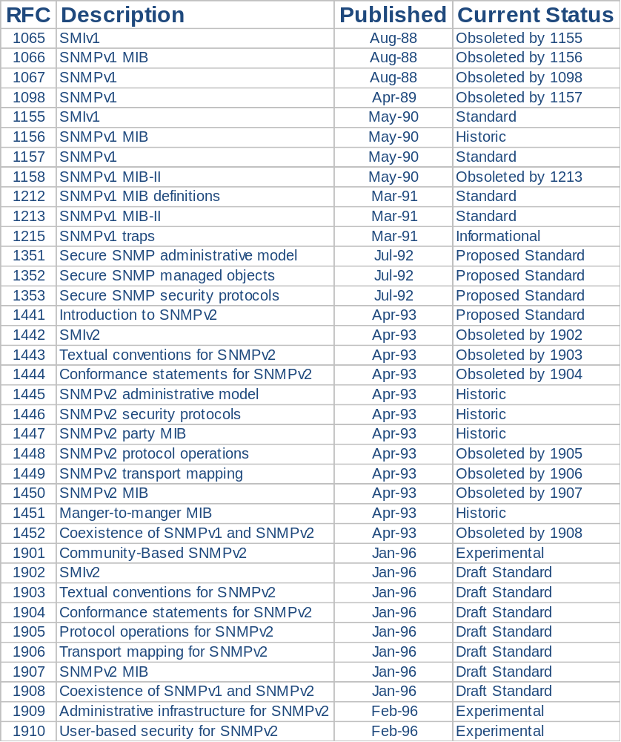
SNMP
RFC’s

Slide 55
Configuration and Maintenance

Slide 56
System Policy
Policies, practices and procedures which are used to make changes to or to maintain the system as a whole, i.e. 'what humans do as part of the system administration process.
Principle 32 (Policy) A clear expression of goals and responses prepares a site for future trouble and documents intent and procedure.

Slide 57
A system policy can include some or all of the following:
Organization: what responsibility will the organization take for its users' actions? What responsibility will the organization take for the users' safety.
• Users: allowing and forbidding certain types of software. Rigid control over space (quotas) or allow freedom A response to software piracy. A response to anti-social behaviour and harassment of others (spamming, obnoxious news postings, etc.) Are users allowed to play games, if so when? Are users allowed to chat online? Policy on garbage collection when disks become full: what files can legitimately be deleted?
Network: will the network be segmented, with different access policies on different
subnets? Firewall ? Ports?
• Mail: limit the size of incoming and outgoing mail. Spam filtering. Virus controls.
• WWW: allowing or forbidding user CGI scripts. Guidelines for allowed content of web pages. Policy regarding advertising on web pages. Load restrictions: what to do if certain pages generate too much traffic. Policy on plagiarism and illegal use of imagery.
• Printing: how many pages can be printed. Is printing of personal documents allowed. Should there be a limit to the number of pages which can be printed at one time (large documents hold up the print queue)?

Slide 58
• Security: physical security of hosts. Backup schedule. Who is allowed to be master of their own hosts? Can arbitrary users mount other users' home directories or mailboxes with NFS on their private PCs (this means that they have automatic access to everyone's personal files)?
Privacy: is encryption allowed? What tools will be provided for private communication?
Synchronizing Clocks
Many security and maintenance issues depend upon clocks being synchronized
correctly.
A more reliable way of keeping clocks synchronized, which works both for Unix and for NT, is the use the NTP protocol, or Network Time Protocol. A time-server is used for this purpose.
The network time protocol daemon xntpd is used to synchronize clocks from a reliable time server.

Slide 59
Executing Jobs at Regular Times
The Unix cron Service
Unix has a time daemon called cr on: it's chronometer. Cron reads a configuration file called a cron tab file which contains a list of shell-commands to execute at regular time intervals.
On modern Unix-like systems, every user may create and edit a crontab file using the command
crontab –e
The format of a crontab file is a number of lines of the form
minutes 0-59 hours 0-23 day 1-31 month 1-12 weekday
Mon-Sun Shellcommand
An asterisk or star * may be used as a wildcard, indicating 'any'. For example:
# Run script every weekday morning Mon-Fri at 3 :15 am:
15 3 * * Mon-Fri /usr/local/bin/script

Slide 60
NT Schedule Service
at command provides a user interface for managing the queue of tasks to execute. The scheduling service is coordinated for all hosts in a domain by the domain server, so the host name on which a batch job is to run can be an argument to the scheduling command.
To schedule a new job to be executed either once or many times in the future, we write:
at host time command
For example:
at 3 : 00pm /next Friday, 13 C : \crsite\host \local \myscript

Slide 61
Tools for Automation
Vendors have also built many system administration products. Their main focus in commercial system administration solutions has been the development of man-machine interfaces for system management. A selection of these projects are described below. They are mainly control-based systems which give responsibility to humans, but some can be used to implement partial immunity type schemes by instructing hosts to execute automatic scripts.
Tivoli is probably the most advanced and wide-ranging product available. It is a Local Area Network (LAN) management tool based on CORBA and X/Open standards; it is a commercial product, advertised as a complete management system to aid in both the logistics of network management and an array of configuration issues.
Tivoli's strength is in its comprehensive approach to management. It relies on encrypted communications and client-server inter-relationships to provide functionality including software distribution and script execution.

Slide 62
Tivoli provides a variety of ways for activating scripts, rather like cfengine:
• Execute by hand when required.
• Schedule tasks with a cron-like feature.
• Execute an action (run a task on a set of hosts, copy a package out) in response to an event.
Sun's Solstice [180] system is a series of shell scripts with a graphical user interface which assists the administrator of a centralized LAN, consisting of Solaris machines, to initially configure the sharing of printers, disks and other network resources.
Host Factory [83] is a third party software system, using a database combined with a revision control system [261] which keeps master versions of files for the purpose of distribution across a LAN.
Host Factory attempts to keep track of changes in individual systems using a method of revision control

Slide 63
Monitoring Tools
Network monitoring advocates have done a substantial amount of "work in perfecting techniques for the capture and decoding of network protocols.
Programs such as etherfind, snoop, tcpdump and bro [196], as well as commercial solutions such as Network Flight Recorder [75], place computers in 'promiscuous mode' allowing them to follow the passing data-stream closely.
Programs like SWATCH watch system logs for conspicuous error messages.

Slide 64
Policy Decisions
The policy must be digested, understood and, not least, obeyed by users and system staff alike:
Determine the system policy. As we have reiterated throughout, no policy can cover every eventuality, not should it be a substitute for thinking. A sensible policy will allow for sufficient flexibility (fault tolerance). A rigid policy is more likely to fail.
• Sysadm team agreement: the team of system administrators need to work together, not against one another. That means that everyone must agree on the policy and enforce it.
• Expect the worst: be prepared for system failure and for rules to be broken. Some kind of police service is required to keep an eye on the system. We can use a script, or an integrated approach like cfengine for this.
• Educate users in good and bad practice, ignorance is our worst enemy. If we educate users in good practice, we reduce the problem of policy trangressions to a few 'criminal‘ users, looking to try their luck
• Special users: do some users require special attention, extra resources, or special assistance? An initial investment catering to their requirements can save time and effort in the long run.

Slide 65
A Diagnostic Principle
Principle (Diagnostics) When you hear the sound of distant hooves, think horses not zebras, i.e. always eliminate the obvious first.
What this means is that we should always look for the most likely explanation before toying with exotic ideas
Establishing Cause and Effect
Our task is to determine the source of that change, and identify a chain of events which resulted in the unfortunate effect
Once a cause has been found, a cure can be simple, but finding the problem itself often requires experience, a large knowledge base and an active imagination.

Slide 66
There is a three stage process:
• Gather evidence from users and from other tests.
• Make an informed guess as to probable cause.
• Try to reproduce (or perhaps just fix) the error.

